Slide 1
Aranoz(Online Furniture Purchasing Website)
Developed By:
Ashwin Ashok(01FB16ECS078)
Aswath S(01FB16ECS080)
Debanik Mishra(01FB16ECS105)
Deekshith Godavarthi(01FB16ECS106)

Slide 2
Skills & expertise
Json,SQL
AJAX
Angular JS
HTML, PHP,JS
Jquery

Slide 3

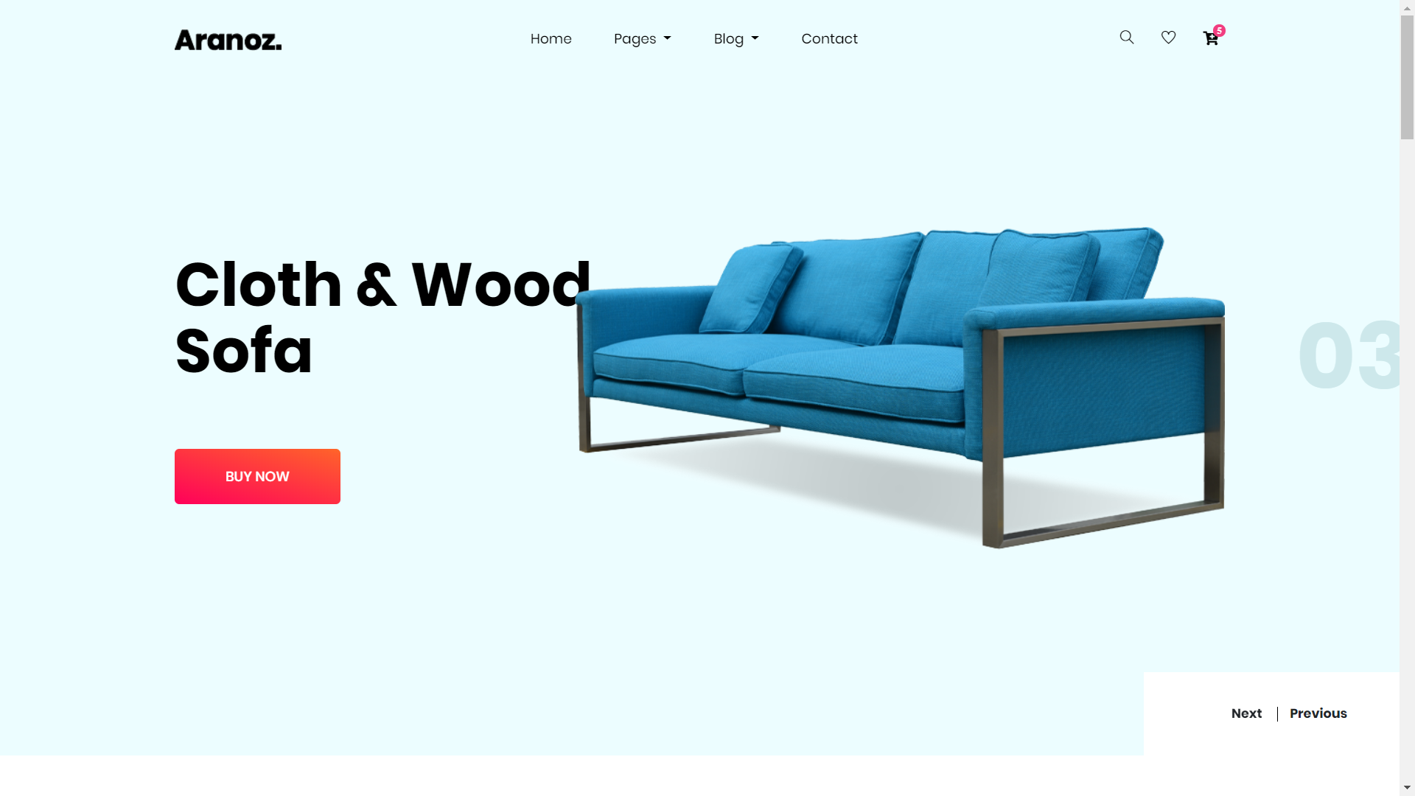
Aranoz.
Components:
AJAX patterns
Multistage Downloading
Long Polling
COMET(Reverse AJAX)
Server Sent Events(Chat app)
Frameworks Used
Angular JS
Bootstrap & JQUERY (UI)
Intelligent Component
Recommendation System(Naive Bayes)
Shopping Cart with dynamic search
MySQL for storing user/customer data.
JSON files for storing item data.

Slide 4

Intelligent Component- Recommendation System
We have implemented Recommendation System as our Intelligent Component in the project.
Naive Bayes’ Theorem finds the probability of an event occurring given the probability of another event that has already occurred.
Based on the items added to the cart it recommends other products to the user.
For Instance, If the user adds 2 lamps and 1 chest of drawers to the cart, then it will recommend 3 lamps and 1 chest of drawers.

Slide 5
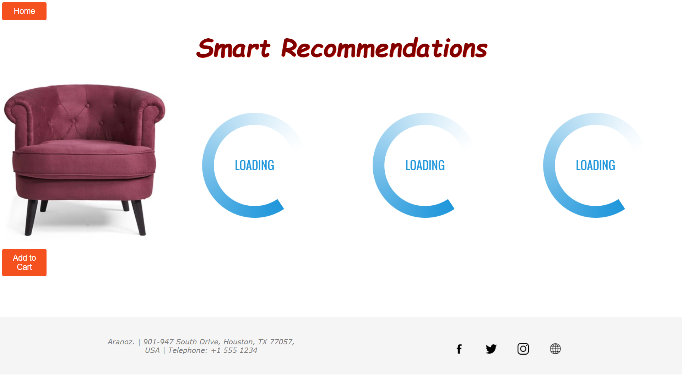
MultiStage Downloading
Multistage Download
Stage 1 - Loads skeleton of the page (text and the footer)
Stage 2 - Loads the Product images that are likely to be chosen further by the user based on the intelligent component.

Slide 6
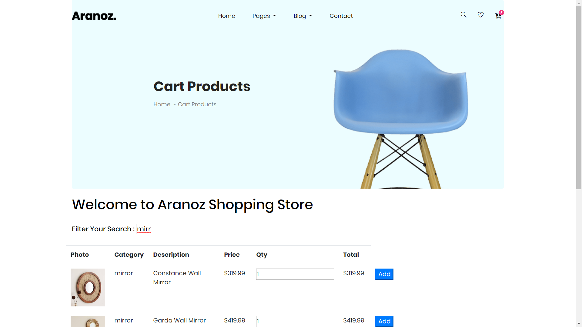
Cart
Adding to the cart is implemented using AngularJS.
AngularJS is distributed as a JavaScript file, and can be added to a web page with a script tag:
Filter Feature is implemented in which based on the user input it filters and displays the items.

Slide 7
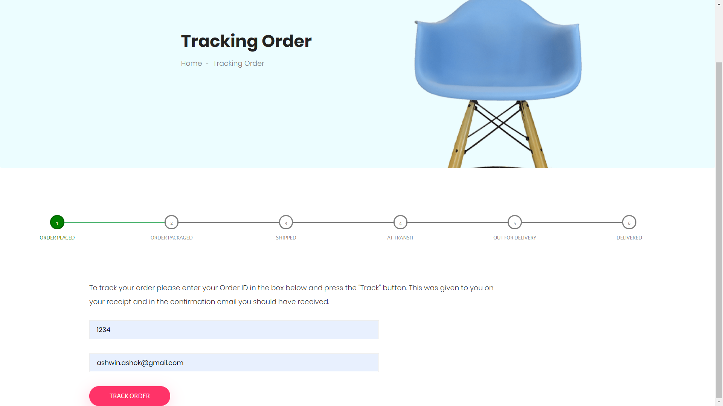
Long Polling
Long Polling is implemented to poll the server without closing the connection.
We request for a change in the status of our Delivery Progress.
An update is rendered to the HTML file which gets updated in the tracking bar spontaneously.

Slide 8
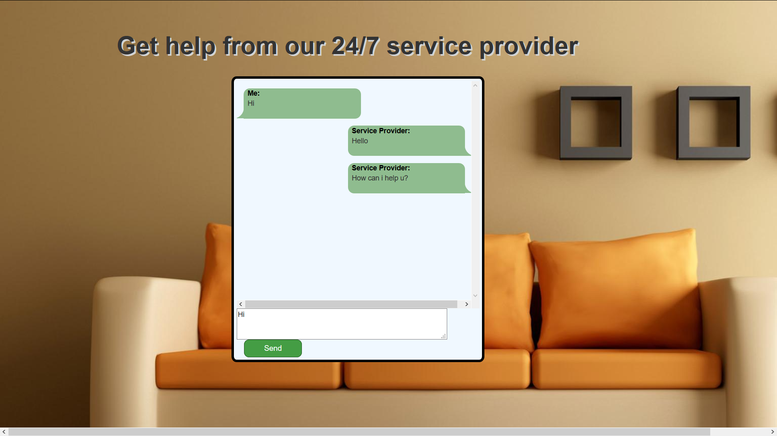
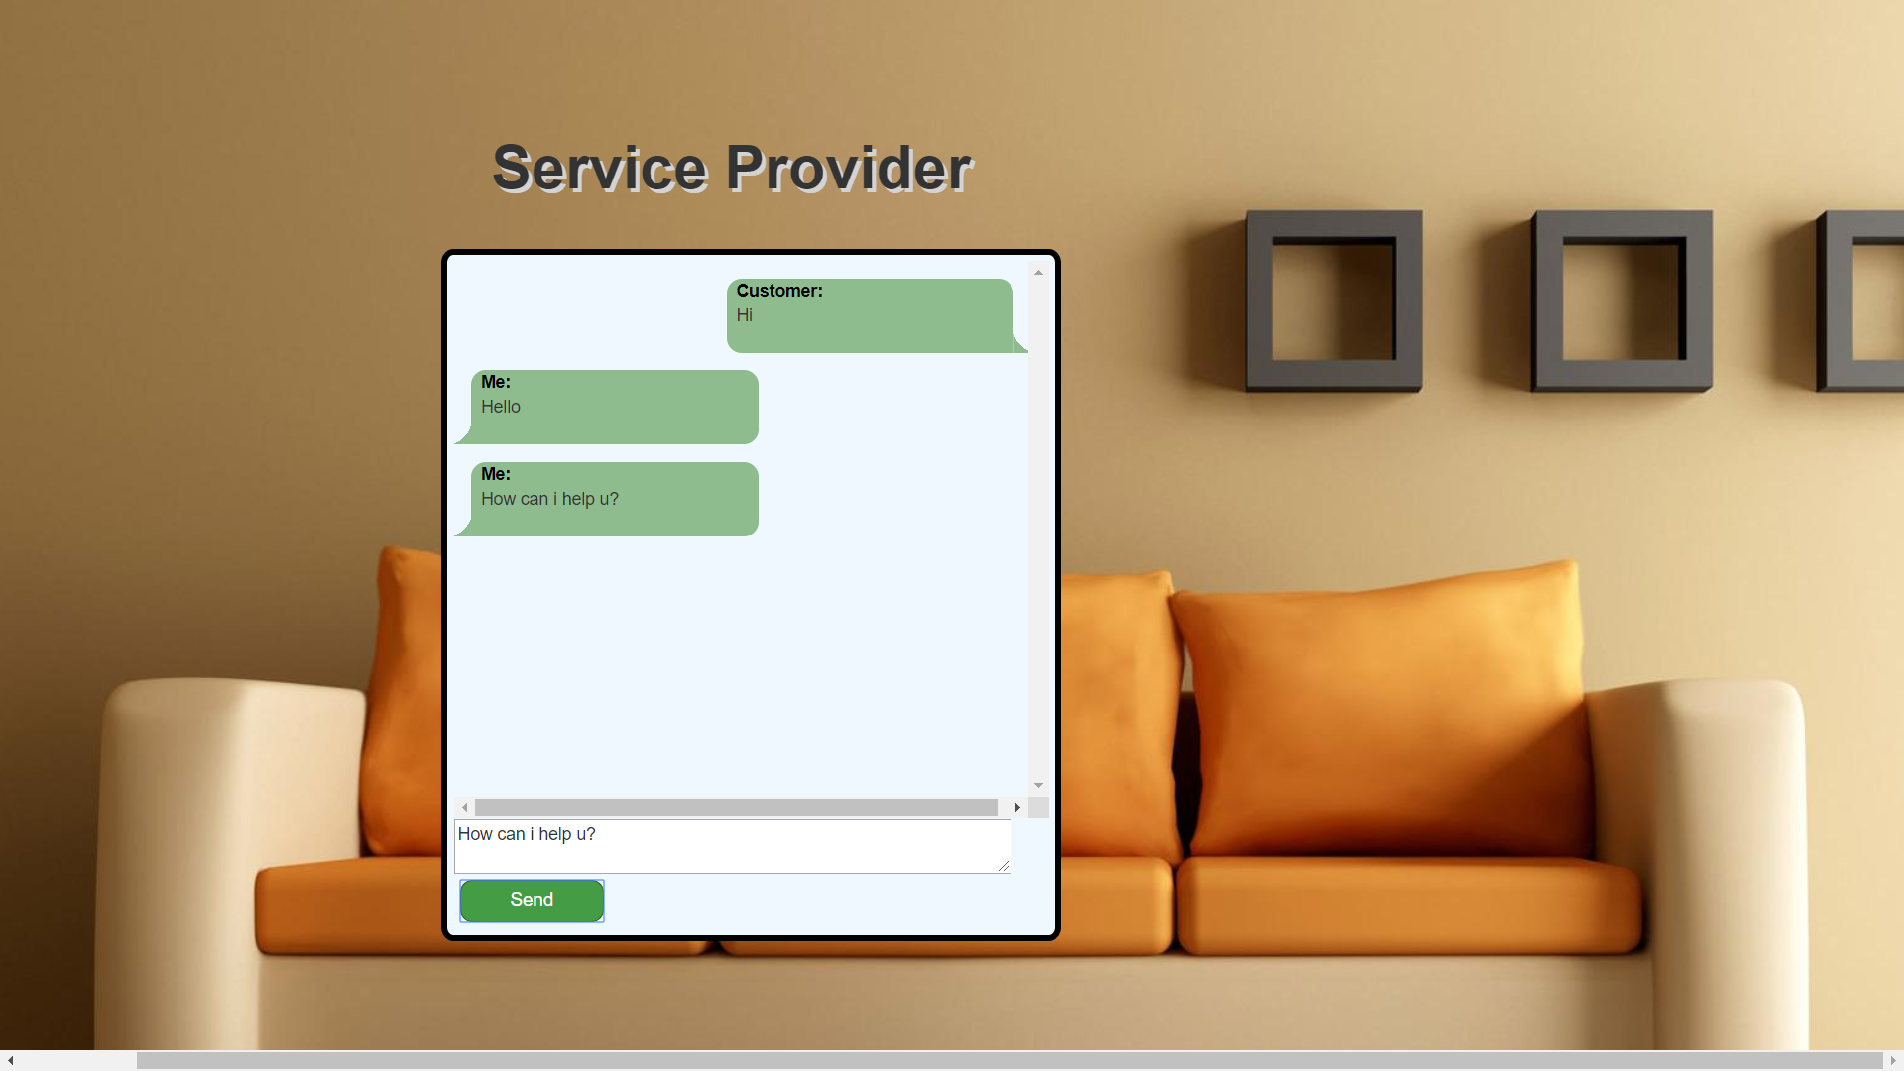
Server Sent Events(Chat)
A server-sent event is an asynchronous, bi-directional, Client-Server application over HTTP.
When the user logins as an admin it categorizers him as a Service Provider who has to handle the requests and queries, whereas when it is a customer it allows him to communicate the Customer Support.

Slide 9
Thank You

